Slide 1
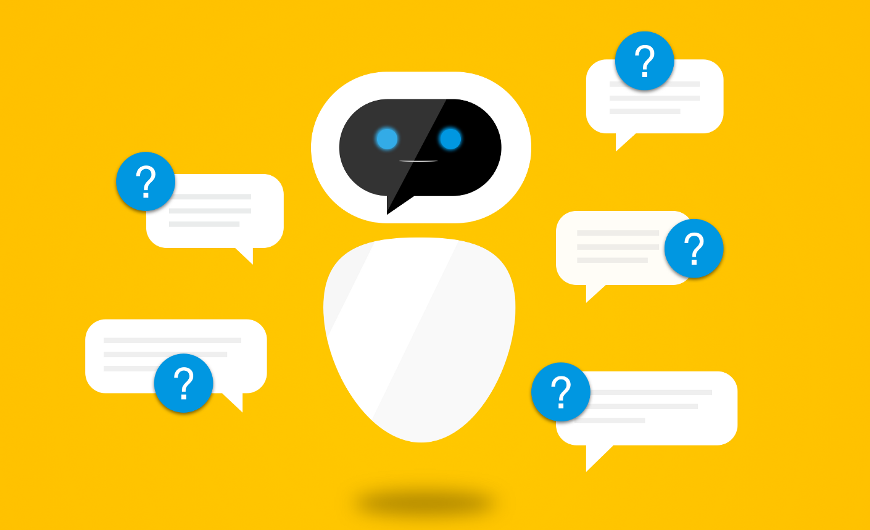
Natural Language Processing

Slide 2


Basics

Slide 3
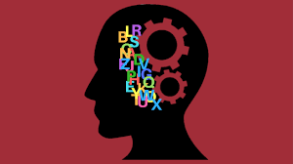
What?
Understanding + analyzing lang.
Speech to text
Complex variables
Slang, slurs, regional dialects

Slide 4


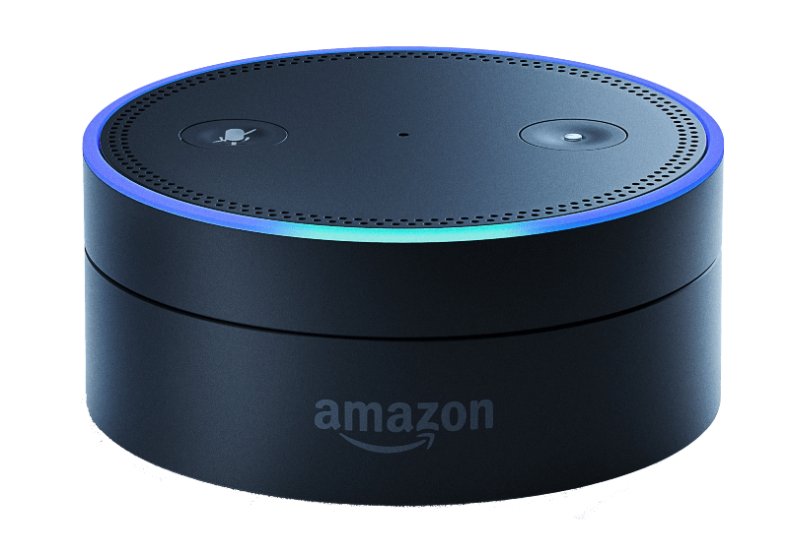
Examples
Siri - Apple
Galaxy - Samsung
Watson - IBM
Cortana - Windows
Echo Dot - Amazon

Slide 5
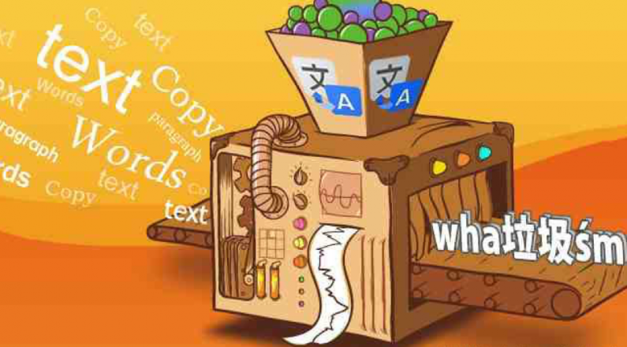
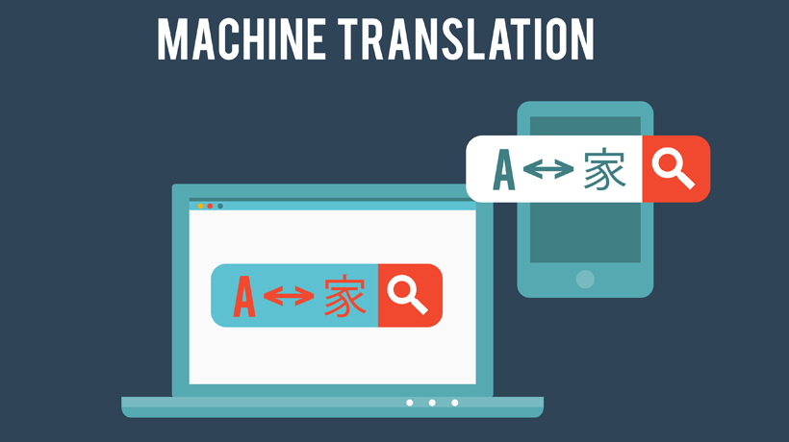
Examples (cont.)
Machine Translation
Google Translate
CHATBOTS!!!!
Applications interacting with users for better experience

Slide 6
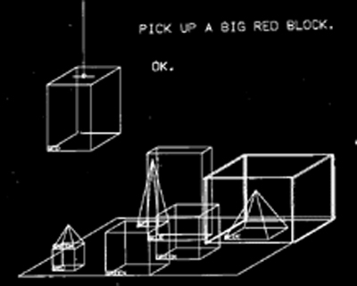
History
1966-1980
Powerful computers
CHATBOT!!!!
SHRDLU
Program dev. @ MIT 1968-1970
Lisp
Accurately understanding lang. & retain memory + understand word in other contexts
Real word applications

Slide 7
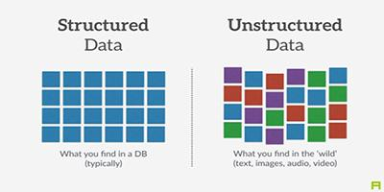
Structured vs. Unstructured Data
Structured
Table
Charts
Data base
Very organized
Unstructured
Long winding text
Difficult to organize

Slide 8

Importance/Impact
Industry advantage
Med : record info in natural manner
Natural way of communication
2020
Free form text
Available data : mostly text

Slide 9


Core Concepts

Slide 10

Stemming and Lemmatization
Reducing word to base form
Lemma : base of word
Stemming : “chopping off” word
Ex : amusing, amusement, amused : stem = amus
Examples
I am a student → I be a student
My computer’s touch screen is not working → My computer touch screen be not working

Slide 11
Differences between Stemming & Lemmatization
Differences
Stemmer : single word, no context
Lemma : appropriate base for diff. Scenarios
Ex : meeting
We are meeting tomorrow, In our meeting yesterday
I saw the most awesome NLP bot!
Stem : I s the most awesome NLP bot!
Lemmatizing : I see the most NLP bot!
Stemming
Flies → fli
Bananas → banana
Lemmatization
Flies → fly
Lemmatization more applied

Slide 12
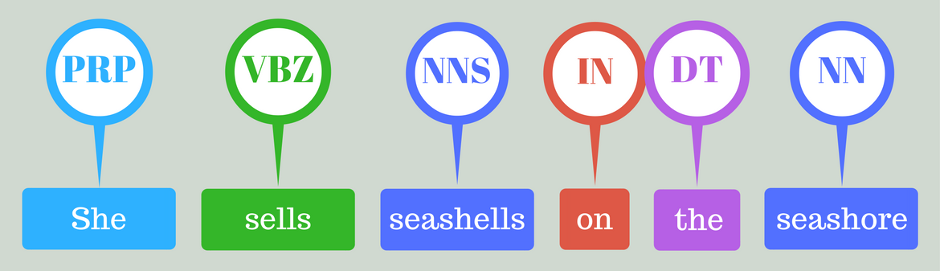
Part of Speech (POS) Tagging
Objective : categorize & assign POS to each word
I want to learn NLP
I (Preposition)
Want (Verb)
Learn (Verb)
NLP (Noun)

Slide 13
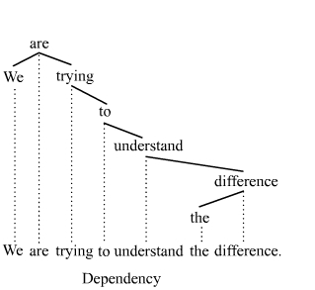
Dependency Parsing
Understand dependencies and relationships of words
Dependency tree
Examples & Terms
Subject
Object
Complement
Modifier

Slide 14
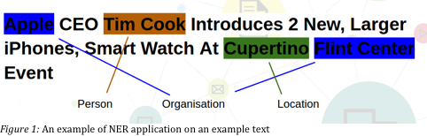
Named Entity Recognition (NER)
Associates entities (categories) with different words
Examples
The Jungle Book : FILM
Plainsboro Public Library : LOCATION
Taylor Swift : SINGER/SONGWRITER

Slide 15
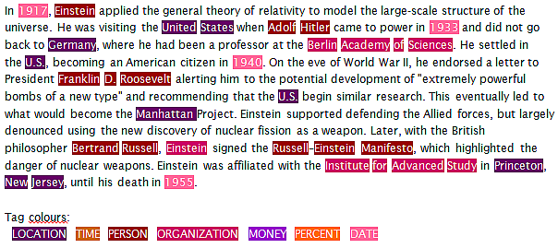
NER Example

Slide 16

Automatic Summarization
Shortening, or summarizing long document
Accuracy
Major points
Examples:
IBM Watson : ability to write good headline
Feed large amt. Of data & Watson has ability to summarize text

Slide 17
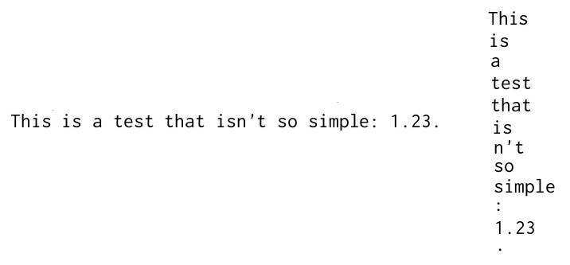
Tokenization
Separate individual words & punctuation marks
Breaking up text by identifying positions of spaces & punctuation

Slide 18
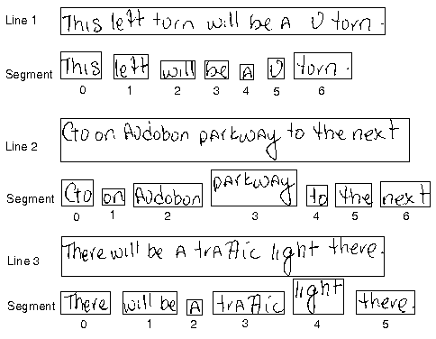
Text Segmentation Example

Slide 19
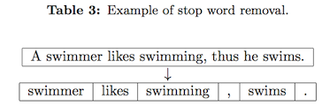
Removal Of Stop Words
Stop words
Don’t contain significance in search queries
Stop words are filtered out of queries (google search)
Examples of Stop Words
A, about, along, behind, etc.
http://xpo6.com/list-of-english-stop-words/
Improves efficiency
Reduces file size

Slide 20
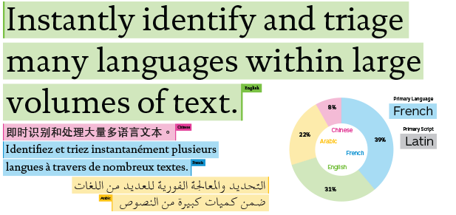
Language Identification
Determines language of content/doc.
After identifying language
Applies best dictionaries for each file
Google Translate

Slide 21
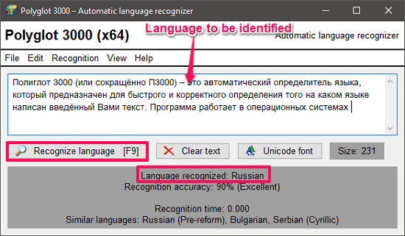
Language Identification Example

Slide 22
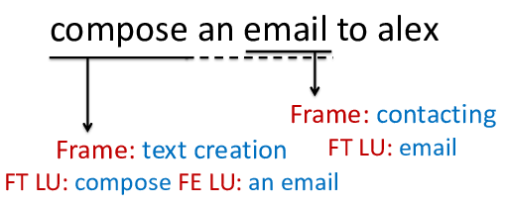
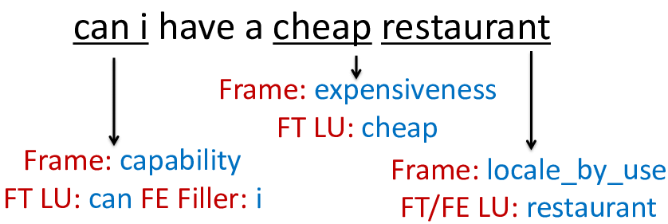
Semantic Parsing
Mapping sentence into a formal rep.
Ability to identify roles
Student, location, food, etc.

Slide 23
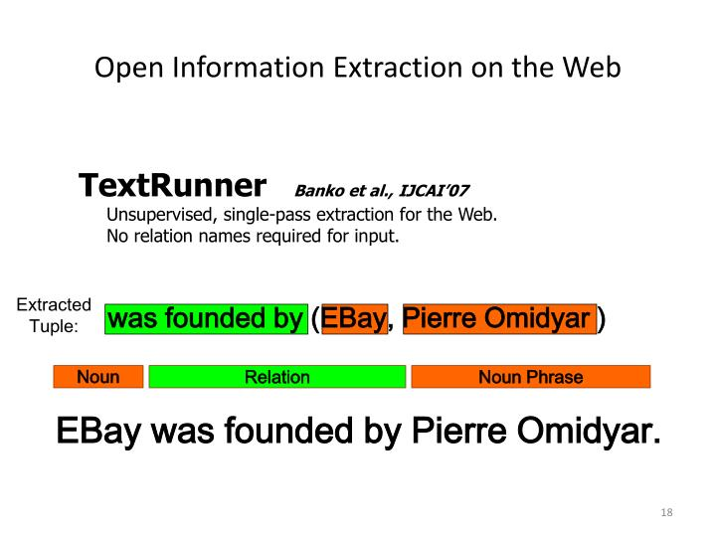
Open Information Extraction (OIE)
Generates machine rep. Of text
Uses POS tagger to establish relationships
Objective
Find relationships expressed in huge datasets
How to find accurate relationships

Slide 24
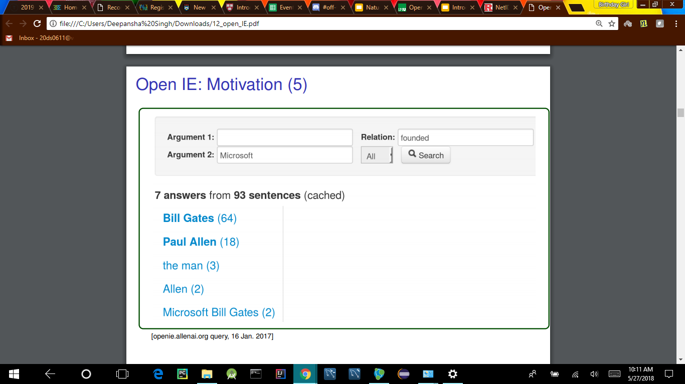
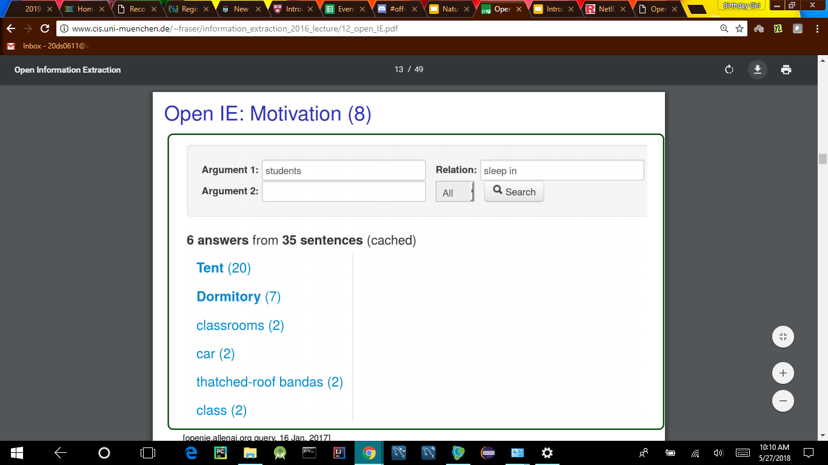
OIE Examples
Huck, Matthias, and Alexander Fraser. “Open Information Extraction.” Http://Www.cis.uni-Muenchen.de/~Fraser/information_extraction_2016_lecture/12_open_IE.Pdf, 18 Jan. 2017.

Slide 25
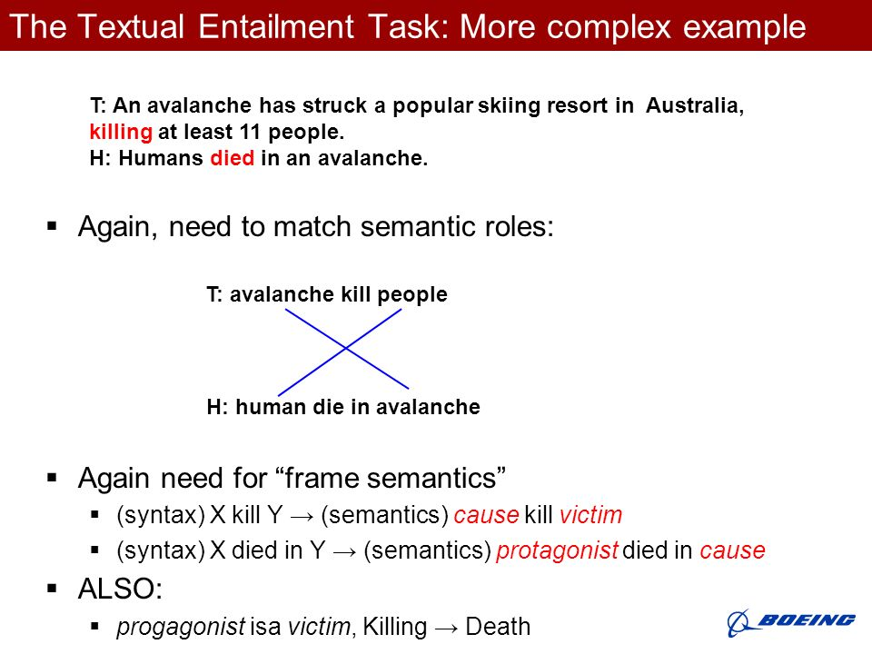
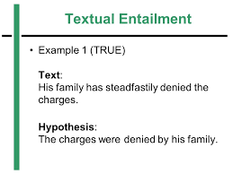
Textual Entailment
Gives direct relation between text fragment & hypothesis

Slide 26

Argumentation Mining
Detection of arguments & relationships
Understanding POV (Point of View) of user
Point vs. counterpoint
Argumentation model components
Claim
Data
Qualifier
Warrant
Rebuttal
Backing

Slide 27
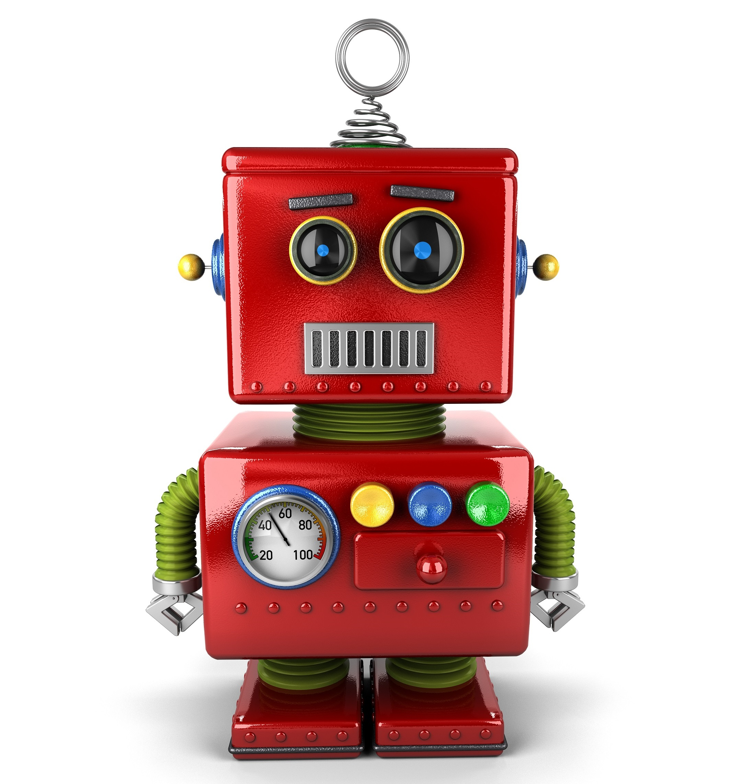

Linguistic Empathy
Ability for machine to understand POV
Point of view of user
Empathize
Empathic chatbots
Building feelings in robots

Slide 28

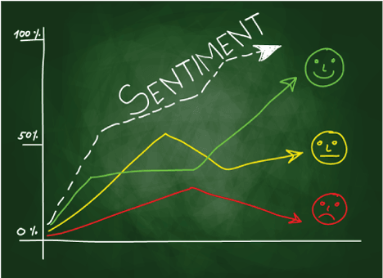
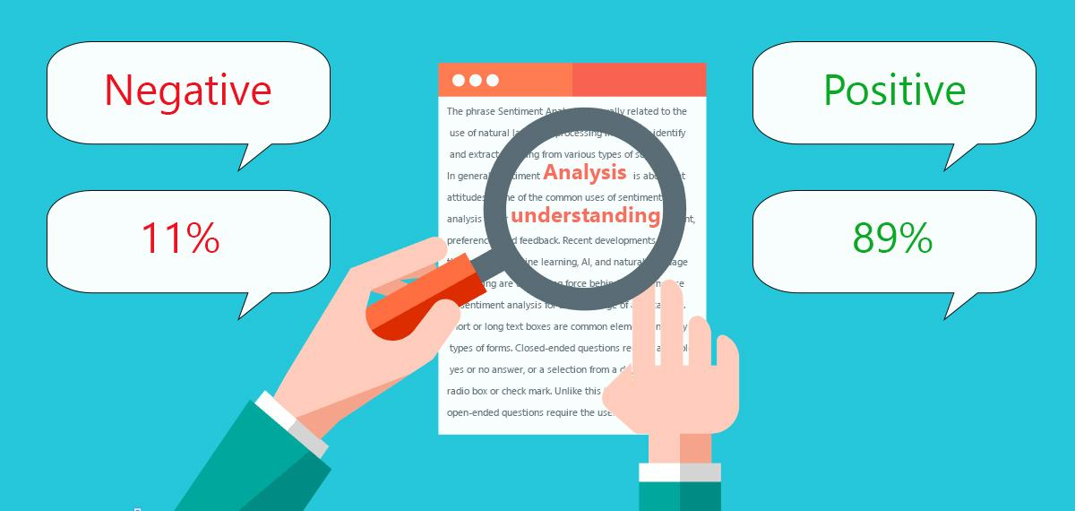
Sentiment Analysis
Ability for machine to understand human emotion
Categorizing + classifying opinions
Positive, negative, or neutral

Slide 29
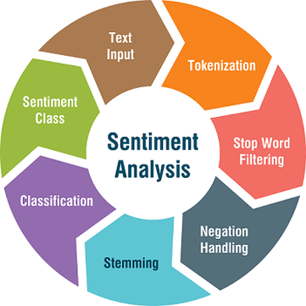
Steps to Sentiment Analysis

Slide 30
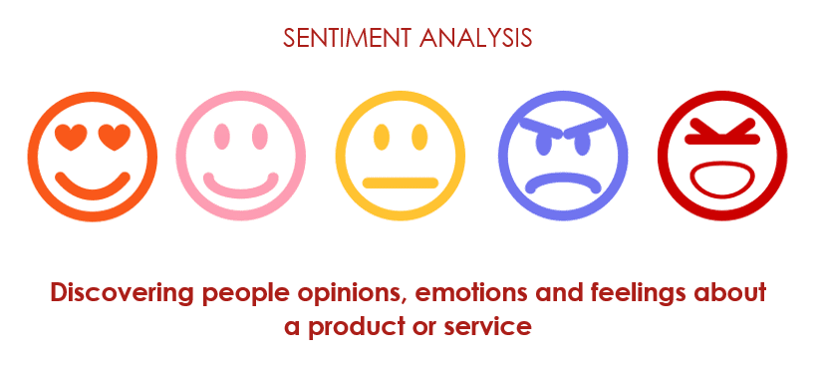
Sentiment Analysis Activity 1
Gather materials
Markers
Paper
Focus on one sentiment
Examples : angry, sad, nervous, etc.
Create a web
In the middle : have sentiment, “anger”, or “sadness”
Branch off words indicating feeling/sentiment(Noun)
Ex : anger → frustrated, infuriated (Adjectives)
Branch off poss. Sentences indicating feeling (Sentence, include verb)
Share & try with Siri/Galaxy/Cortana.

Slide 31

Chatbot Activity
(IBM Chatbots for Good)

Slide 32
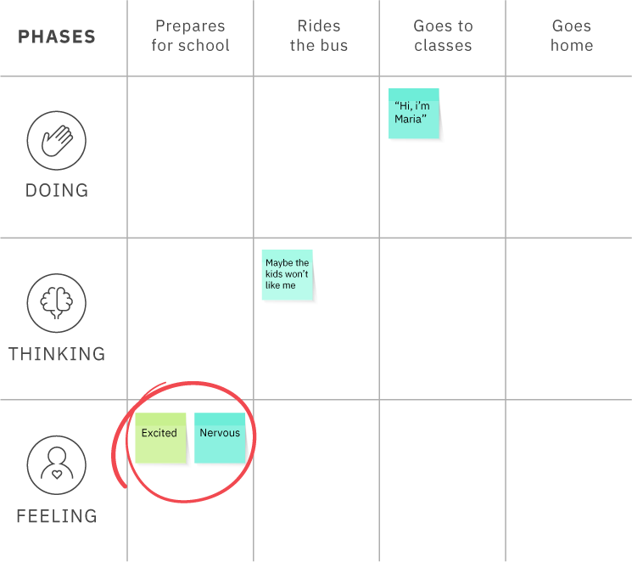
Step 1 : Scenario Map
Draw 4 rows
Phases row
Write down actions/phases
Ex : new student at school
Prepares for school, etc.
4-6 phases
Doing row
Actions person is performing
Thinking row
Person’s internal thoughts
Feelings row
Use marker to circle most intense moments (terrified, nervous)

Slide 33

Step 2 : Creating Solutions
Choose one of the circled items
Brainstorm possible solution ideas
Different POVs
Ex : As a teacher, I can guide a new student through the school.
Ex : As a student, I can help the new student by...

Slide 34
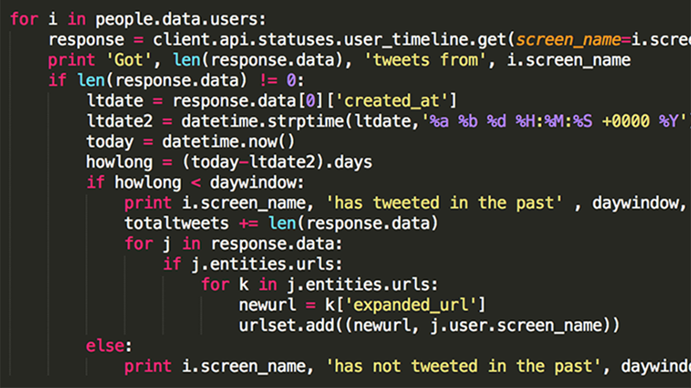
Step 3 : Code - Outside of Workshop @ Home
Code and step by step process to create simple chatbot @ home
Resources and info. @ end of presentation
Resources will be posted on Classroom

Slide 35
What are Bots?
https://www.youtube.com/watch?time_continue=60&v=fEbzk4vTHsQ
https://www.youtube.com/watch?v=uE_WJTnqUwA

Slide 36

Examples of Sentiment Analysis Driven Chat Bots
Woebot : https://woebot.io/
Siri, Alexa, Cortana, Echo Dot, Watson, etc.
https://www.youtube.com/watch?v=lmKqmPoU2ec

Slide 37
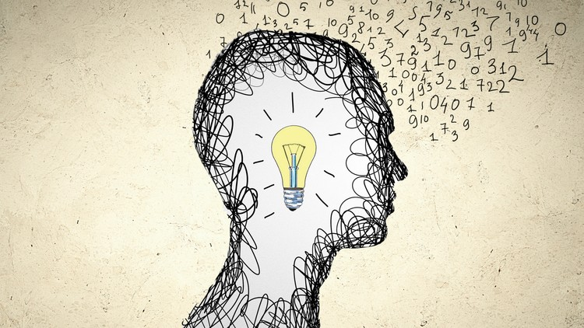
NLP With Java
& Python

Slide 38
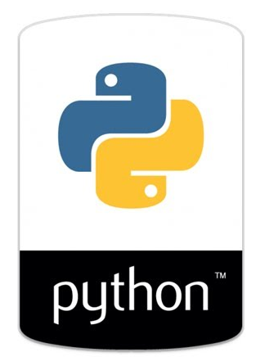
Resources
Java
Eclipse - IDE
Basics on classes, etc.
If/else statements
Import Stanford Core NLP APIs or Apache OpenNLP
Python
JetBrains PyCharms or IDLE
Basics on Python
Logic if/else statements
Import Natural Language Toolkit (NLTK) libraries
NLTK performs all the NLP concepts we discussed

Slide 39

Steps with Java/Python
Download & Install __
Go through tutorial posted on classroom (posted by tomorrow)
Code I wrote, step by step procedure with meaning
After understanding code, copy + run in IDE
Run and see the result!

Slide 40
How Watson Really Works
https://www.youtube.com/watch?v=_Xcmh1LQB9I

Slide 41
Cognitive Computing : Machine uses AI concepts to simulate human thinking by self learning through recognizing patterns and developing models

